Slide 1
How do oil reserves affect CO₂ emissions in the United States from 1990 - 2021?
Moustafa Ibrahim

Slide 2
Introduction
Greenhouse gas emissions from oil use contribute significantly to climate change.
Future oil scarcity and rising prices influence car sales and energy costs.
Unconstrained CO2 emissions from fossil fuel burning drive anthropogenic global warming.
Shift to alternative energy sources is critical to combat climate change and ensure sustainability.

Slide 3
CO2 Emission Journey
5. Per Capita CO2 Emission
1. Oil Reserves
CO2 Emission Journey
4. Amount of Cars Sold
2. Crude Oil Price
3. Annual Gas Price

Slide 4
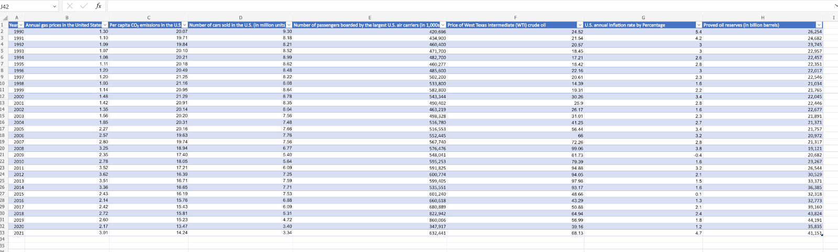
Approach Taken
Data collection was done utilizing Statista, the OECD, and International Energy Agency (IEA). Data was collected for the years 1990 - 2021 for a comprehensive 30 years.
Once the variables were selected, data files were downloaded from respective database. The downloading created 6 separate excel files of raw data. The raw data was taken into a shared Excel file to be organized to reflect the years 1990-2021 to become organized data. Our cleaned and organized data was used to make visualizations.

Slide 5
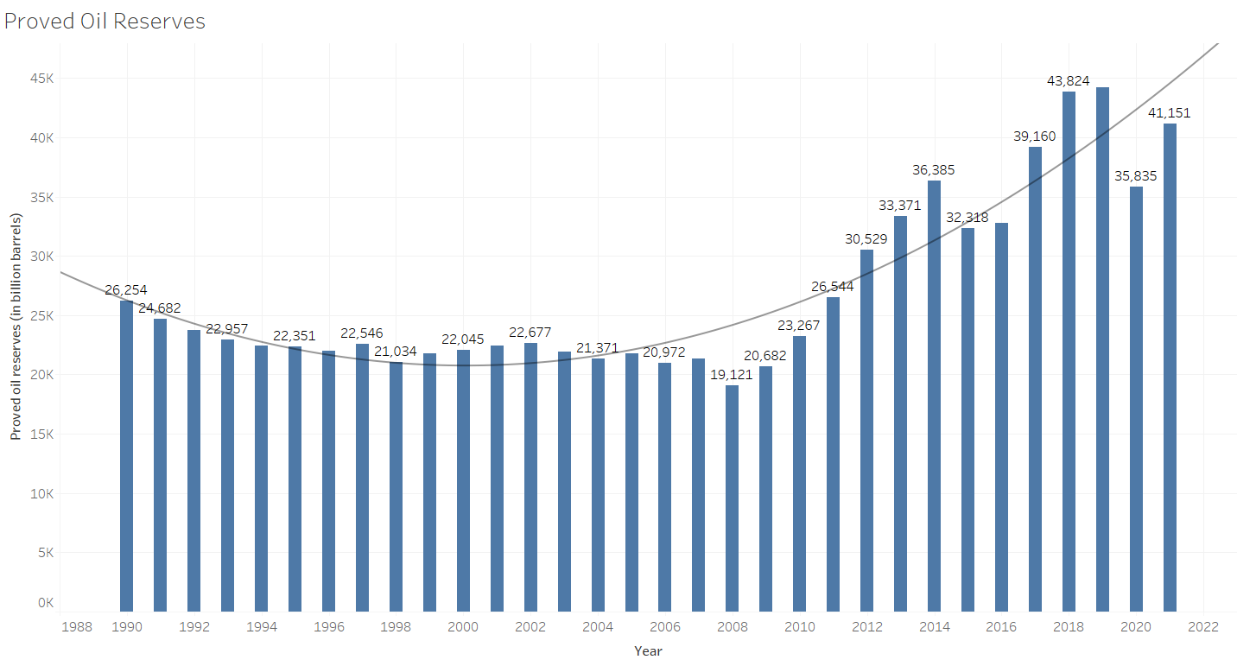
Proved Oil Reserves 1990-2021
Proved Oil Reserves evolution over the span of 31 years, from 1990 to 2021.
2008 seems to be a turning point in the amount of the US proved oil reserves.

Slide 6
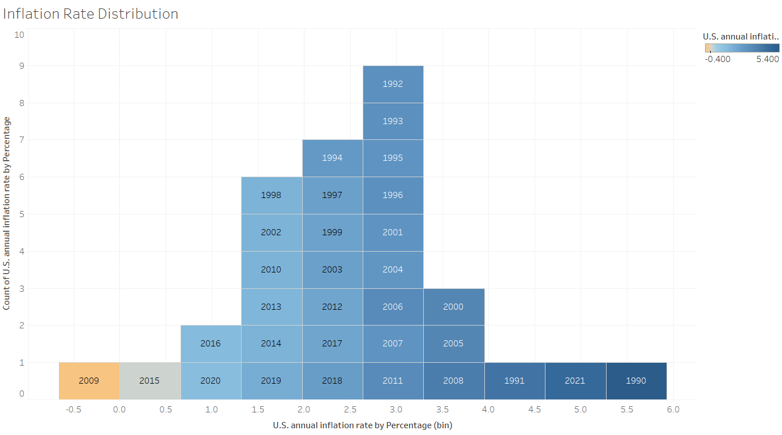
Inflation Rate 1990-2021
The visualization shows inflation distribution from 1990-2021.
The histogram is positively skewed that lower inflation values occurred more than the higher values

Slide 7
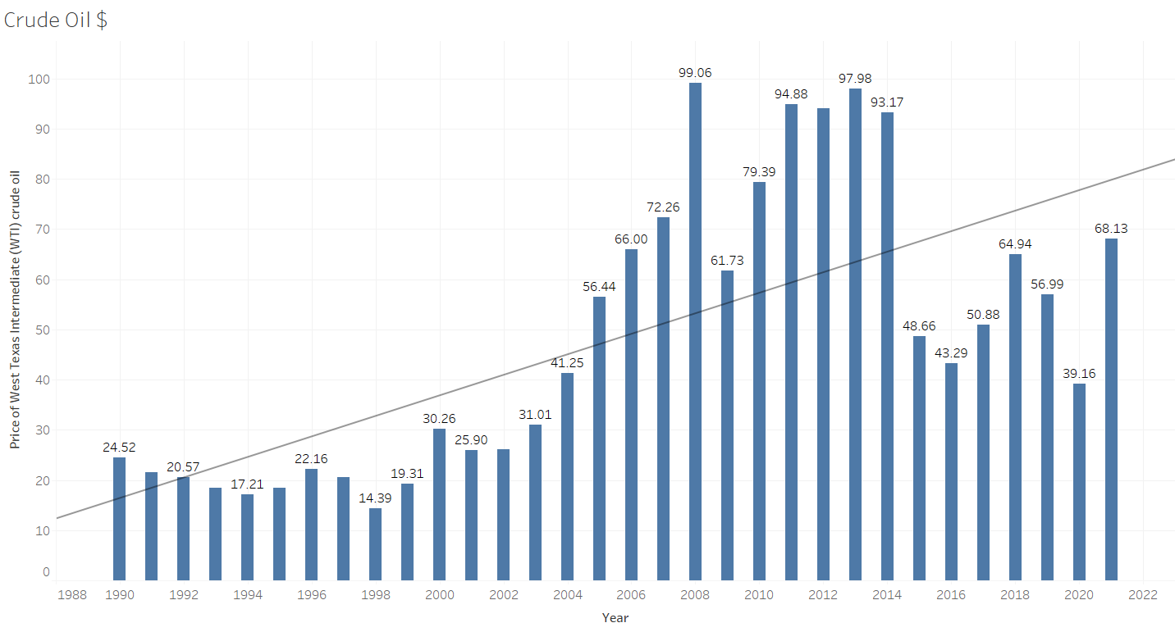
Crude Oil Price
The bar chart shows the evolution, ups, and downs of the crude oil price over the period of 31 years.
The visualization shows the impact of different historical events on the crude oil price in the US.

Slide 8
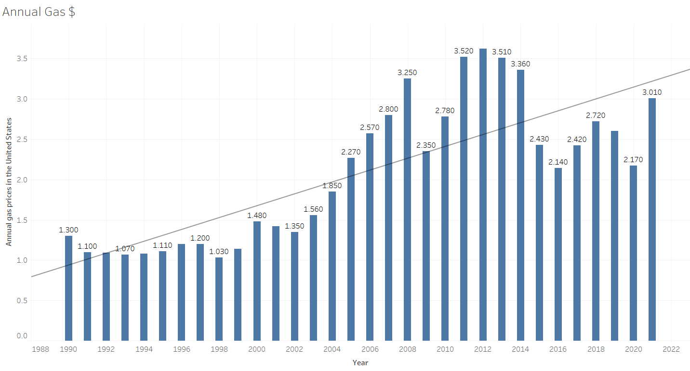
Annual Gas Price
The bar chart visualizes how the average annual gas price evolved since 1990 to 2021.
Many confounding variables are taking on this timeline, such as the financial crises, COVID-19, wars, etc..

Slide 9
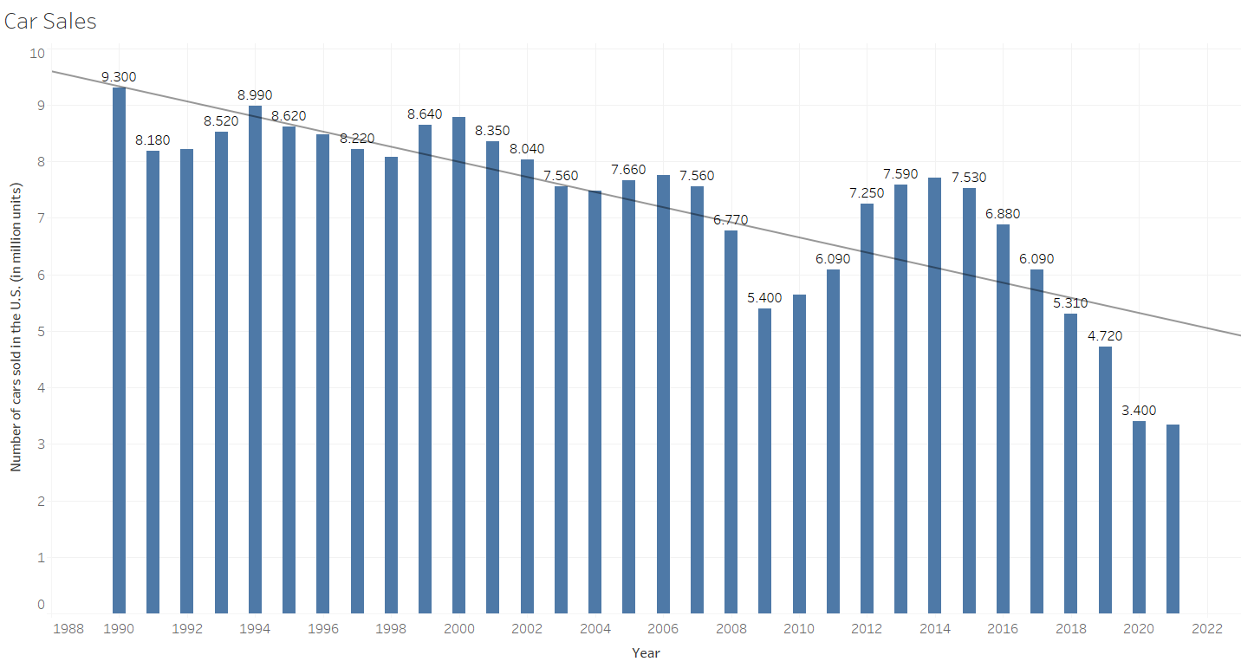
Car Sales (in Million Units)
This bar charts shows how the car sales go down over time.
As the visualization shows that the car sales declined overtime, but dropped drastically during the financial crises and the COVID-19 pandemic.

Slide 10
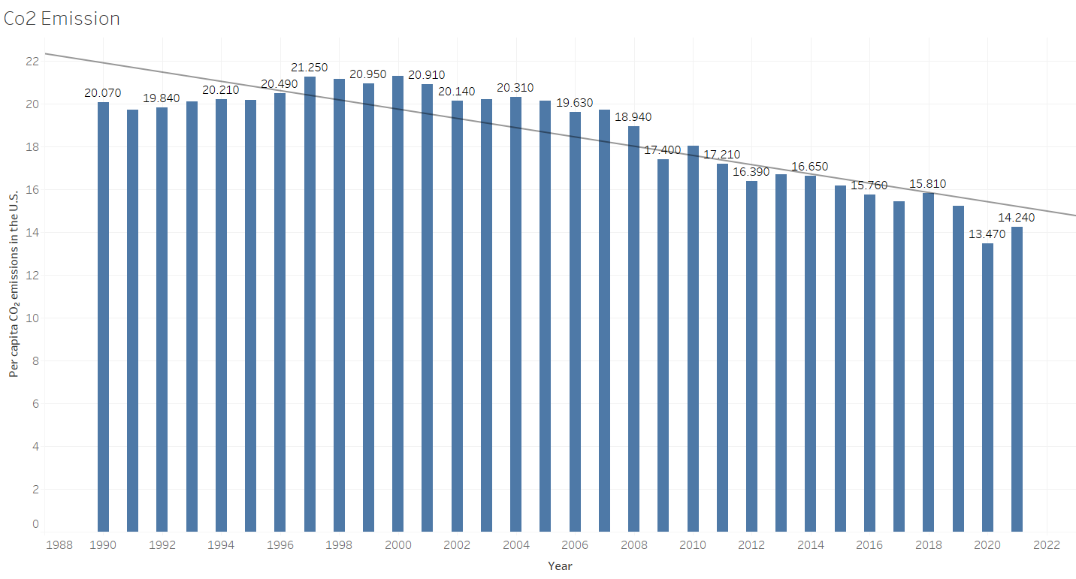
CO₂ Emission (Per Capita)
This bar charts represents the Per Capita CO₂ Emission since 1990 up to 2021.

Slide 11
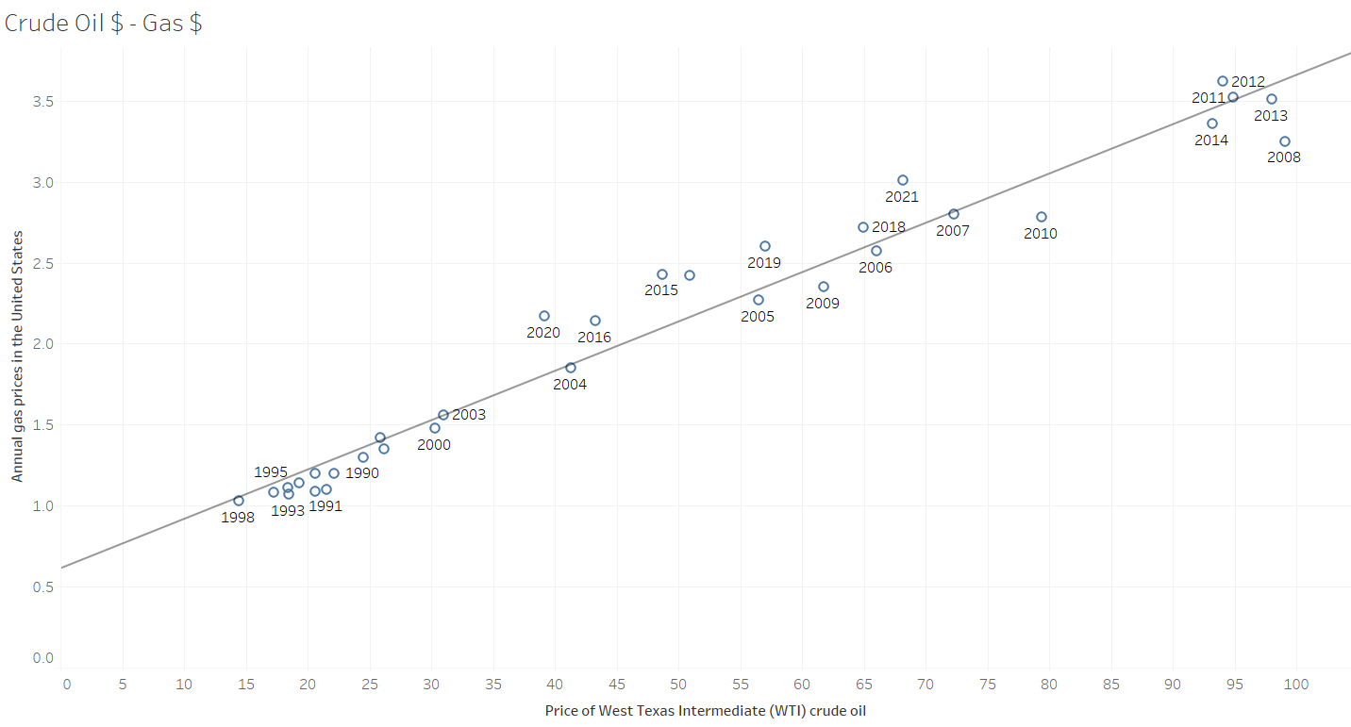
The Impact of Crude Oil on the Gas Price
This scatter plot depicts the correlation between the Crude Oil Price and the average Annual Gas Price.
The correlation seems high, directly proportional.

Slide 12
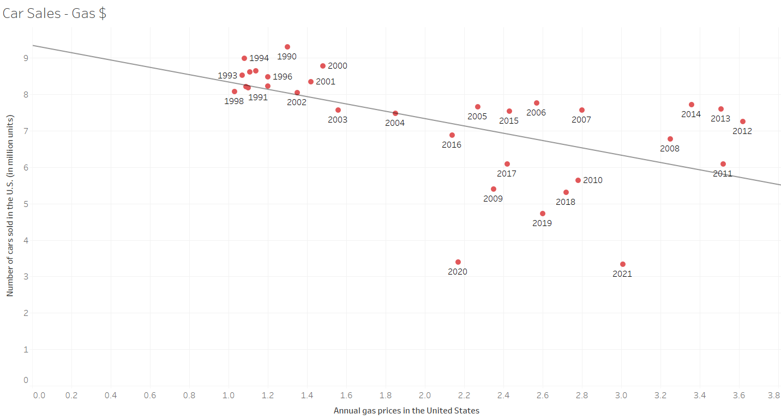
The Impact of Gas Price on Car Sales
This scatter plot visualizes the correlation between the gas price and car sales.
Both variables are moderately correlated, especially when disregarding the outliers, the years 2020 and 2021, which were the COVID-19 years that hindered most good productions and sales. These two events act as confounders.

Slide 13
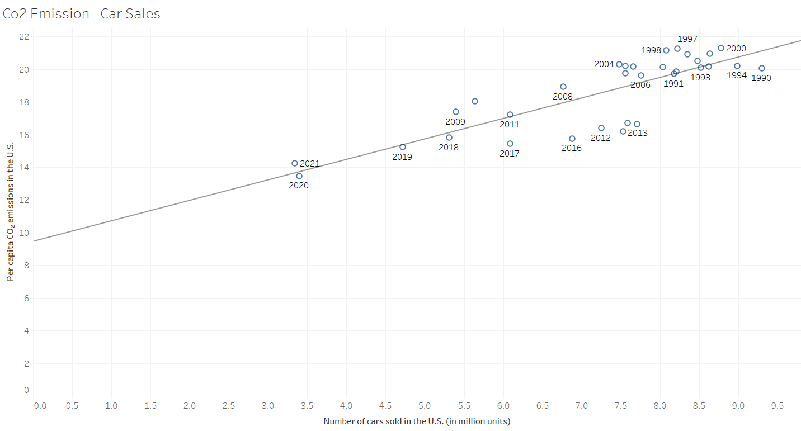
How does Car Sales contribute to CO₂ Emission?
This CO₂ and Car Sales scatter plot depicts the strong correlation the two variables have.
They are directly proportional.

Slide 14
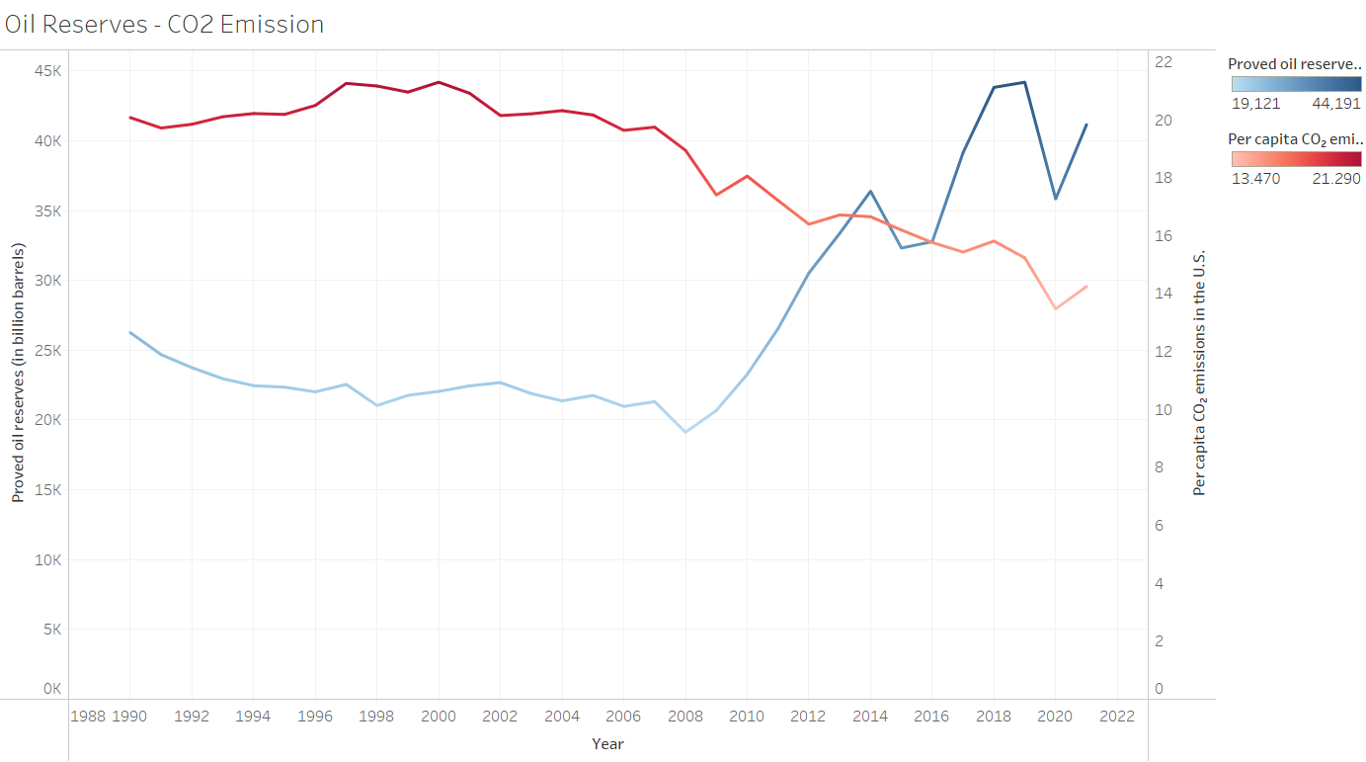
The More, the Less - Inversely Proportional
Oil Reserves and CO₂ Emission are the first and last rings of the chain, respectively.
This line visualization depicts the inverse correlation the two variables have.

Slide 15
Insights Gained
Proved Oil Reserves and Per Capita CO₂ Emission has strong negative correlation, approximately -0.86.
The more Oil Reserves the US has, the less Per Capita CO₂ Emission produced, and vice versa.
Crude Oil Price and Annual Gas Price have a very strong positive correlation, approximately 0.97.
The car sales affects the per capita CO₂ Emissions.

Slide 16
Discussion
Growing awareness among the public about the environmental and economic impact of oil consumption.
Increasing public demand for sustainable and eco-friendly alternatives in the automotive industry.
Public's purchasing decisions influence market trends, encouraging the adoption of energy-efficient vehicles.
Public engagement in advocating for government policies promoting renewable energy and carbon reduction.
Role of the public in educating peers and communities, fostering a collective understanding of the urgency to transition to alternative energy sources.

Slide 17
Conclusion
The urgency of the environmental and economic challenges demands immediate and collective action.
Success relies on international collaboration, involving governments, industries, and the public.
The necessity to transition from oil-dependent practices to sustainable, low-carbon alternatives is imperative.
A collective responsibility to address oil-related issues for the well-being of current and future generations.
By embracing sustainable energy practices and advocating for change, there is hope for a healthier planet and a more sustainable future.

Slide 18
References
BEA. (March 2, 2023). Annual passenger car sales in the United States from 1951 to 2022 (in million units) [Graph]. In Statista. Retrieved May 02, 2023, from https://www.statista.com/statistics/199974/us-car-sales-since-1951/
Bureau of Labor Statistics. (January 25, 2023). Annual inflation rate in the United States from 1990 to 2022 [Graph]. In Statista. Retrieved May 02, 2023, from https://www-statista-com.proxy.libraries.rutgers.edu/statistics/191077/inflation-rate-in-the-usa-since-1990/
BP. (July 8, 2021). Proved oil reserves in the United States from 1980 to 2020* (in billion barrels) [Graph]. In Statista. Retrieved May 02, 2023, from https://www-statista-com.proxy.libraries.rutgers.edu/statistics/236687/proven-crude-oil-reserves-in-the-usa-since-1980/
EIA. (March 28, 2023). Carbon dioxide emissions from energy consumption in the United States from 1975 to 2022* (in million metric tons of carbon dioxide) [Graph]. In Statista. Retrieved May 02, 2023, from https://www-statista-com.proxy.libraries.rutgers.edu/statistics/183943/us-carbon- dioxide-emissions-from-1999/
EIA. (January 10, 2022). Retail price of regular gasoline in the United States from 1990 to 2021 (in U.S. dollars per gallon) [Graph]. In Statista. Retrieved May 02, 2023, from https://www-statista-com.proxy.libraries.rutgers.edu/statistics/204740/retail-price-of-gasoline-in-the-united-states- since-1990/
en2x. (April 18, 2023). Average annual West Texas Intermediate (WTI) crude oil price from 1976 to 2023 (in U.S. dollars per barrel) [Graph]. In Statista. Retrieved May 02, 2023, from https://www-statista-com.proxy.libraries.rutgers.edu/statistics/266659/west-texas-intermediate-oil-prices/
Peñuelas, J., & Carnicer, J. (2010). Climate change and peak oil: the urgent need for a transition to a non-carbon-emitting society. Ambio, 39(1), 85–90. https://doi.org/10.1007/s13280-009-0011-x

